Slide 1
Basic Data Analysis
Emanuele Della Valle
Prof. @ Politecnico di Milano
Founder & Partner @ Quantia Consulting
Marco Balduini
Founder & CEO @ Quantia Consulting
Riccardo Tommasini
Prof. @ INSA Lyon (France)

Slide 2
Introduction

Slide 3
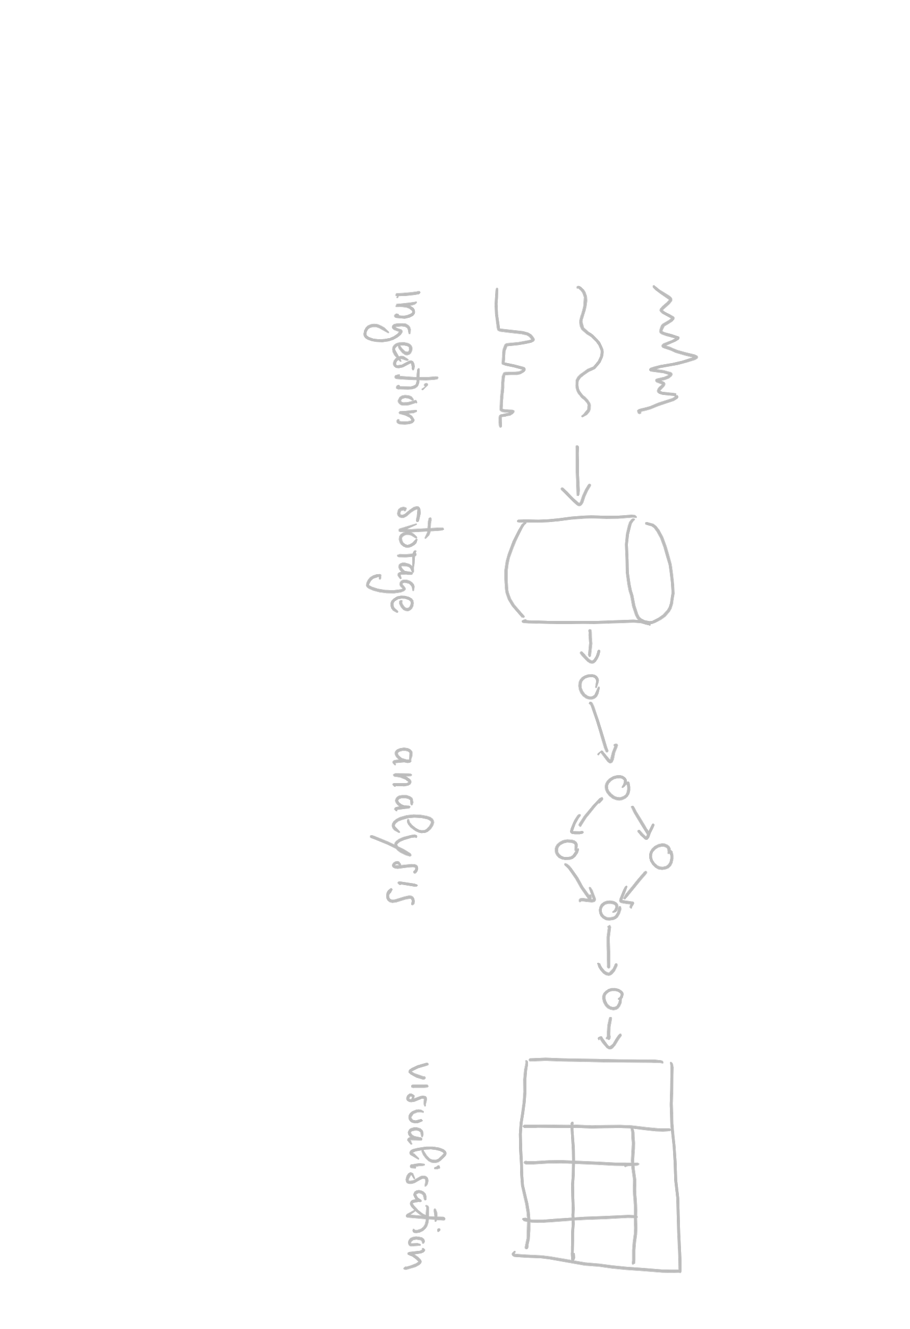
Data Lifecycle

Slide 4
Data Lifecycle

Slide 5

Data Lifecycle

Slide 6


Slide 7
Why Flux?
I don't want to have to write query code in one language and processing code in another language.
– Paul Dix - CTO InfluxData

Slide 8
What Is Flux?
Flux Query Language?
Flux Query Language?
Query + Process + Act
Flux Data Scripting Language
Notes:
Suggesrico Ask – Process + Act
Cosi da eliminare Query

Slide 9
What Is Flux?
Written to be:
Useable: easy to learn
Testable: queries are code
Readable: developers read more code than we write
Extensible: developers can extend the language
Composable: developers can build onto the language

Slide 10
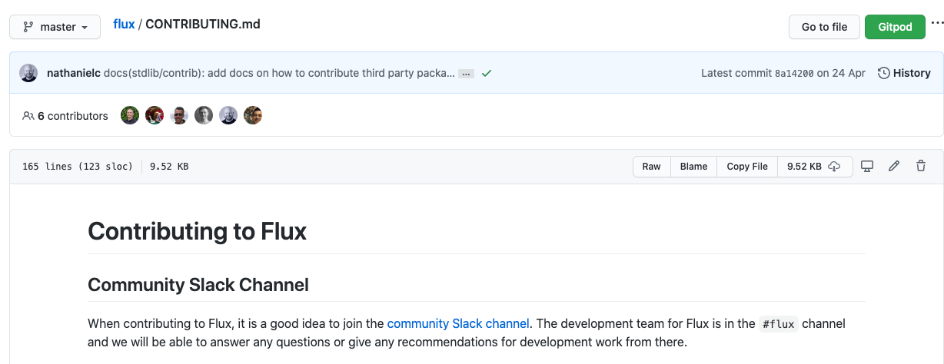
Flux is Open

Slide 11
What is Flux? (cont.)
MIT License
Data-first mentality
Streaming Data
Planner-optimized
Compatible with multiple sources and sinks

Slide 12
Exploring Flux Basics

Slide 13
Basic Flux Language Elements
Anatomy of a Flux script:
data source
time range
data filters

Slide 14
Basic Flux Language Elements
Anatomy of a Flux script:
data source
time range
data filters
from(bucket:"telegraf/autogen")

Slide 15
Basic Flux Language Elements
Anatomy of a Flux script:
data source
time range
data filters
from(bucket:"telegraf/autogen")
|> range(start:-1h)

Slide 16
Basic Flux Language Elements
Anatomy of a Flux script:
data source
time range
data filters
from(bucket:"telegraf/autogen")
|> range(start:-1h)
|> filter(fn: (r) =>

Slide 17
Basic Flux Language Elements
Anatomy of a Flux script:
data source
time range
data filters
from(bucket:"telegraf/autogen")
|> range(start:-1h)
|> filter(fn: (r) =>
r._measurement == "oven" and
r._field == "temp" and
r._value > 300.0)

Slide 18
Basic Flux Language Elements
Anatomy of a Flux script:
data source
time range
data filters
Anonymous function
from(bucket:"telegraf/autogen")
|> range(start:-1h)
|> filter(fn: (r) =>
r._measurement == "oven" and
r._field == "temp" and
r._value > 300.0)

Slide 19
Basic Flux Language Elements
Anatomy of a Flux script:
data source
time range
data filters
Anonymous function
from(bucket:"telegraf/autogen")
|> range(start:-1h)
|> filter(fn: (r) =>
r._measurement == "oven" and
r._field == "temp" and
r._value > 300.0)
Pipe-forward operator: chain operations together

Slide 20
Basic Flux Language Elements
Anatomy of a Flux query:
data source
time range
data filters
from(bucket:"telegraf/autogen")
|> range(start:-1h)
|> filter(fn: (r) =>
r._measurement == "oven" and
r._field == "temp" and
r._value > 300.0)

Slide 21
Basic Flux Language Elements
Anatomy of a Flux query:
data source
time range
data filters
parameter(s)
from(bucket:"telegraf/autogen")
|> range(start:-1h)
|> filter(fn: (r) =>
r._measurement == "oven" and
r._field == "temp" and
r._value > 300.0)

Slide 22
Basic Flux Language Elements
Anatomy of a Flux query:
data source
time range
data filters
parameter(s)
from(bucket:"telegraf/autogen")
|> range(start:-1h)
|> filter(fn: (r) =>
r._measurement == "oven" and
r._field == "temp" and
r._value > 300.0)
expression(s)

Slide 23
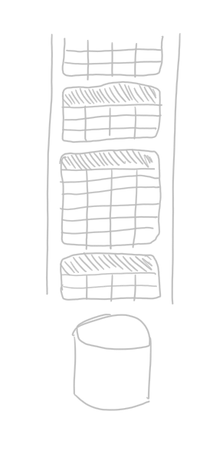
Flux Data Model
An infinite stream…
of finite tables…
identified by the GroupKey

Slide 24
From bucket to tables
_time
_m
host
temp
humidity
14…0
obs
ovenA
301
23
…
…
…
…
…
14…1
obs
ovenB
125
75
_m = _measurement

Slide 25
From bucket to tables
from(bucket:"telegraf/autogen")
|> range(start:-1s)
_time
_m
host
temp
humidity
14…0
obs
ovenA
301
23
…
…
…
…
…
14…1
obs
ovenB
125
75
_m = _measurement

Slide 26
From bucket to tables
_time | _m | host | _field | _value
14…0 | obs | ovenA | humidity | 23
14…2 | obs | ovenA | humidity | 21
GroupKey[obs, ovenA, humidity]
from(bucket:"telegraf/autogen")
|> range(start:-1s)
_time
_m
host
temp
humidity
14…0
obs
ovenA
301
23
…
…
…
…
…
14…1
obs
ovenB
125
75
_m = _measurement

Slide 27
From bucket to tables
_time | _m | host | _field | _value
14…0 | obs | ovenA | humidity | 23
14…2 | obs | ovenA | humidity | 21
GroupKey[obs, ovenA, humidity]
_time | _m | host | _field | _value
14…1 | obs | ovenA | temp | 301
14…3 | obs | ovenA | temp | 303
GroupKey[obs, ovenA, temp]
from(bucket:"telegraf/autogen")
|> range(start:-1s)
_time
_m
host
temp
humidity
14…0
obs
ovenA
301
23
…
…
…
…
…
14…1
obs
ovenB
125
75
_m = _measurement

Slide 28
From bucket to tables
_time | _m | host | _field | _value
14…0 | obs | ovenA | humidity | 23
14…2 | obs | ovenA | humidity | 21
GroupKey[obs, ovenA, humidity]
_time | _m | host | _field | _value
14…1 | obs | ovenA | temp | 301
14…3 | obs | ovenA | temp | 303
GroupKey[obs, ovenA, temp]
_time | _m | host | _field | _value
14…1 | obs | ovenB | temp | 125
14…2 | obs | ovenB | temp | 127
GroupKey[obs, ovenB, temp]
[…]
from(bucket:"telegraf/autogen")
|> range(start:-1s)
_time
_m
host
temp
humidity
14…0
obs
ovenA
301
23
…
…
…
…
…
14…1
obs
ovenB
125
75
_m = _measurement

Slide 29
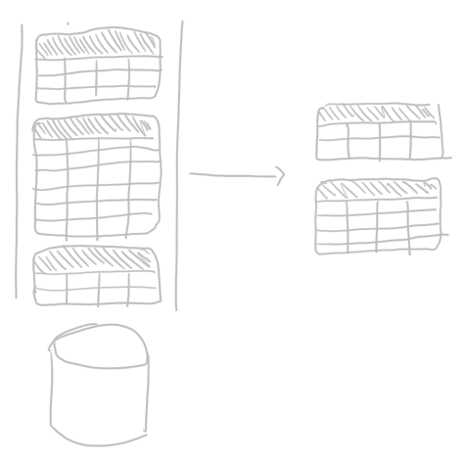
Query Process
For Each Table:
Convert incoming rows into 0 or more outgoing rows
Map outgoing rows to tables

Slide 30
_time | _m | host | _field | _value
14…0 | obs | ovenA | humidity | 23
14…2 | obs | ovenA | humidity | 21
GroupKey[obs, ovenA, humidity]
_time | _m | host | _field | _value
14…1 | obs | ovenA | temp | 301
14…3 | obs | ovenA | temp | 303
GroupKey[obs, ovenA, temp]
[…]
_time | _m | host | _field | _value
14…1 | obs | ovenB | temp | 125
14…2 | obs | ovenB | temp | 127
GroupKey[obs, ovenB, temp]

Slide 31
_time | _m | host | _field | _value
14…0 | obs | ovenA | humidity | 23
14…2 | obs | ovenA | humidity | 21
GroupKey[obs, ovenA, humidity]
|> filter(fn: (r) =>
r._measurement == "obs" and
r._field == "temp" and
(r._value >= 303 or
r._vaule <= 125)
_time | _m | host | _field | _value
14…1 | obs | ovenA | temp | 301
14…3 | obs | ovenA | temp | 303
GroupKey[obs, ovenA, temp]
[…]
_time | _m | host | _field | _value
14…1 | obs | ovenB | temp | 125
14…2 | obs | ovenB | temp | 127
GroupKey[obs, ovenB, temp]

Slide 32
_time | _m | host | _field | _value
14…0 | obs | ovenA | humidity | 23
14…2 | obs | ovenA | humidity | 21
GroupKey[obs, ovenA, humidity]
∅
|> filter(fn: (r) =>
r._measurement == "obs" and
r._field == "temp" and
(r._value >= 303 or
r._vaule <= 125)
_time | _m | host | _field | _value
14…1 | obs | ovenA | temp | 301
14…3 | obs | ovenA | temp | 303
GroupKey[obs, ovenA, temp]
[…]
_time | _m | host | _field | _value
14…1 | obs | ovenB | temp | 125
14…2 | obs | ovenB | temp | 127
GroupKey[obs, ovenB, temp]

Slide 33
_time | _m | host | _field | _value
14…0 | obs | ovenA | humidity | 23
14…2 | obs | ovenA | humidity | 21
GroupKey[obs, ovenA, humidity]
∅
|> filter(fn: (r) =>
r._measurement == "obs" and
r._field == "temp" and
(r._value >= 303 or
r._vaule <= 125)
_time | _m | host | _field | _value
14…1 | obs | ovenA | temp | 301
14…3 | obs | ovenA | temp | 303
GroupKey[obs, ovenA, temp]
_time | _m | host | _field | _value
14…3 | obs | ovenA | temp | 303
GroupKey[cpu, ovenA, temp]
[…]
_time | _m | host | _field | _value
14…1 | obs | ovenB | temp | 125
14…2 | obs | ovenB | temp | 127
GroupKey[obs, ovenB, temp]

Slide 34
_time | _m | host | _field | _value
14…0 | obs | ovenA | humidity | 23
14…2 | obs | ovenA | humidity | 21
GroupKey[obs, ovenA, humidity]
∅
|> filter(fn: (r) =>
r._measurement == "obs" and
r._field == "temp" and
(r._value >= 303 or
r._vaule <= 125)
_time | _m | host | _field | _value
14…1 | obs | ovenA | temp | 301
14…3 | obs | ovenA | temp | 303
GroupKey[obs, ovenA, temp]
_time | _m | host | _field | _value
14…3 | obs | ovenA | temp | 303
GroupKey[cpu, ovenA, temp]
[…]
[…]
_time | _m | host | _field | _value
14…1 | obs | ovenB | temp | 125
GroupKey[cpu, ovenB, temp]
_time | _m | host | _field | _value
14…1 | obs | ovenB | temp | 125
14…2 | obs | ovenB | temp | 127
GroupKey[obs, ovenB, temp]

Slide 35
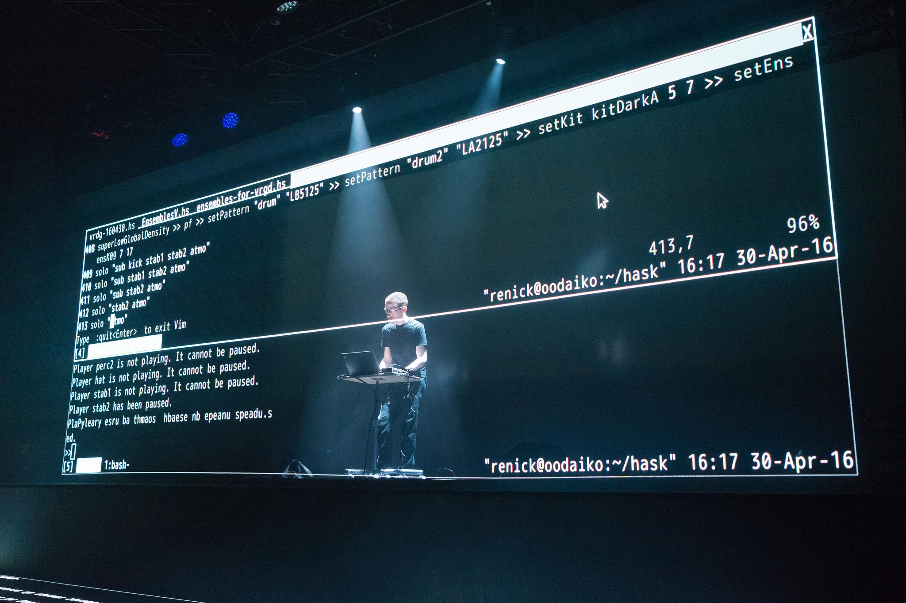
Let’s do some live coding

Slide 36
The Life of a Flux Query
Client
Server
query text
Parser
AST
Evaluator
Query Op-Spec
Procedure Spec
Planner/ Optimizer
Transformation Spec
:)

Slide 37
The Life of a Flux Query
Client

Slide 38
The Life of a Flux Query
Client
query text

Slide 39
The Life of a Flux Query
Client
query text
Parser
Notes:
parsing -> errori scrittura

Slide 40
The Life of a Flux Query
Client
query text
Parser
AST
Notes:
ast -> abstract syntactic tree albero sintattico

Slide 41
The Life of a Flux Query
Client
query text
Parser
AST
Evaluator
Notes:
evaluator if there are any answer

Slide 42
The Life of a Flux Query
Client
query text
Parser
AST
Evaluator
Query Op-Spec
Notes:
code generator that prepares the codes to sent to server

Slide 43
The Life of a Flux Query
Client
query text
Parser
AST
Evaluator
Query Op-Spec
Procedure Spec
Notes:
predecural specification -> procedure lanciate sul server in un altro linguaggio

Slide 44
The Life of a Flux Query
Client
query text
Parser
AST
Evaluator
Query Op-Spec
Procedure Spec
Planner/ Optimizer
Notes:
ottimizzazione

Slide 45
The Life of a Flux Query
Client
query text
Parser
AST
Evaluator
Query Op-Spec
Procedure Spec
Planner/ Optimizer
Transformation Spec
Notes:
esecuzione per ritorno dei dati

Slide 46
The Life of a Flux Query
Client
Server
query text
Parser
AST
Evaluator
Query Op-Spec
Procedure Spec
Planner/ Optimizer
Transformation Spec
:)
Notes:
Quelle in verde chiaro sono sul client ma non visibili all’utente

Slide 47

Quiz
What’s a Bucket?
What’s the Pipe-forward operator |> for?
What’s a result Table in Flux?
What’s a Group Key in Flux?
List of columns for which every row in a table has the same value
A named data source with retention policy
Chains operations
A part of a result

Slide 48
Quiz
What’s a Bucket?
What’s the Pipe-forward operator |> for?
What’s a result Table in Flux?
What’s a Group Key in Flux?
[1:B]
List of columns for which every row in a table has the same value
A named data source with retention policy
Chains operations
A part of a result

Slide 49
Quiz
What’s a Bucket?
What’s the Pipe-forward operator |> for?
What’s a result Table in Flux?
What’s a Group Key in Flux?
[1:B, 2:C]
List of columns for which every row in a table has the same value
A named data source with retention policy
Chains operations
A part of a result

Slide 50
Quiz
What’s a Bucket?
What’s the Pipe-forward operator |> for?
What’s a result Table in Flux?
What’s a Group Key in Flux?
[1:B, 2:C, 3:D]
List of columns for which every row in a table has the same value
A named data source with retention policy
Chains operations
A part of a result

Slide 51
Quiz answer
What’s a Bucket?
What’s the Pipe-forward operator |> for?
What’s a result Table in Flux?
What’s a Group Key in Flux?
[1:B, 2:C, 3:D, 4:A]
List of columns for which every row in a table has the same value
A named data source with retention policy
Chains operations
A part of a result

Slide 52
Exploring Flux Windowing

Slide 53

Key concepts
window
Data Sources
Registered Continuous Query
streams of answer
input streams
E. Della Valle

Slide 54
Windows
Streams are infinite in nature

Slide 55
Windows
Streams are infinite in nature
Processing can end only if the input is finite

Slide 56
Windows
Streams are infinite in nature
Processing can end only if the input is finite
A window operator selects a finite portion of a stream
Time range is a window operator whose input is a time interval specified either stating an absolute start and end time
range(start: 2019-10-01T00:00:00Z, stop: 2019-10-01T00:05:00Z)
or stating a relative time period relative
range(start:-2h, stop: -1h)
range(start:-1h)

Slide 57

Let’s get dirty!
2

Slide 58
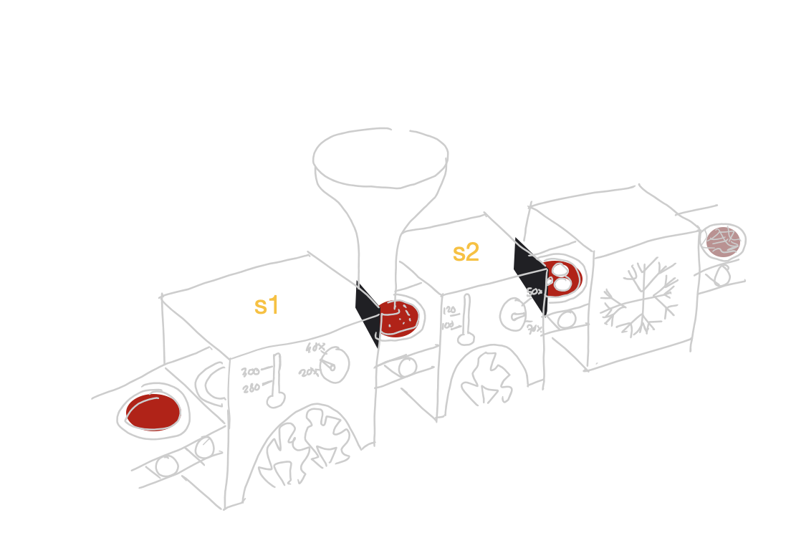
Continuous Linear Pizza Oven
Learning goals:
Data source
Window
Tables

Slide 59
Task
Extract all the measurements in a given range
Absolute: from 2020-10-26T12:00:00Z to 2020-10-26T12:05:00Z
Relative: in the last 24 hours
Take home message
The range() function extracts from the named bucket all the possible tables in the given time range

Slide 60
Let’s do some live coding

Slide 61
Let’s get dirty!
3

Slide 62
Continuous Linear Pizza Oven
Learning goals:
Filter by Tag

Slide 63
Task
Extract the temperature data from the cooking base area (sensor S1)
Take home message
The filter() function applied to tags selects only the table(s) of your interest from all the possible tables

Slide 64
Let’s do some live coding

Slide 65
Let’s get dirty!
4

Slide 66
Continuous Linear Pizza Oven
Learning goals:
Filter by value

Slide 67
Task
Extract the measurements from the cooking base area (sensor S1) with a temperature under 300°
Take home message
The filter() function applied to values selects only the row(s) of your interest from all the possible tables

Slide 68
Let’s do some live coding

Slide 69
Exploring Flux Shaping and Processing

Slide 70
All Flux Language Elements
Anatomy of a Flux script:
data source
time range
data filters
from(bucket:"telegraf/autogen")
|> range(start:-1h)
|> filter(fn: (r) =>
r._measurement == "oven" and
r._field == "temp" and
r._value > 300.0)

Slide 71
All Flux Language Elements
Anatomy of a Flux script:
data source
time range
data filters
shaping
from(bucket:"telegraf/autogen")
|> range(start:-1h)
|> filter(fn: (r) =>
r._measurement == "oven" and
r._field == "temp" and
r._value > 300.0)
|> group(columns: ["_field"])

Slide 72
All Flux Language Elements
Anatomy of a Flux script:
data source
time range
data filters
shaping
processing
from(bucket:"telegraf/autogen")
|> range(start:-1h)
|> filter(fn: (r) =>
r._measurement == "oven" and
r._field == "temp" and
r._value > 300.0)
|> group(columns: ["_field"])
|> mean()

Slide 73
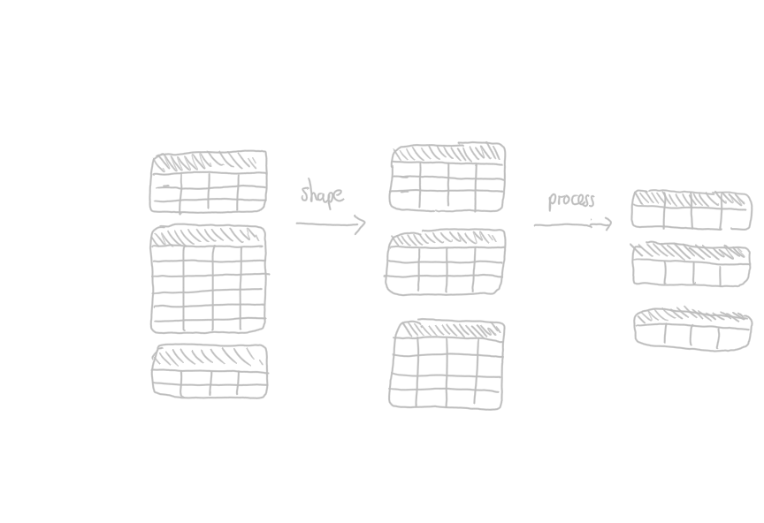

Slide 74
Exploring flux
Shaping with group
Processing with aggregators and selectors

Slide 75
_time | _m | host | _field | _value
10:45 | obs | ovenA | humidity | 10
11:45 | obs | ovenA | humidity | 20
GroupKey[obs, ovenA, humidity]
_time | _m | host | _field | _value
11:00 | obs | ovenB | humidity | 60
11:30 | obs | ovenB | humidity | 70
GroupKey[obs, ovenB, humidity]
_time | _m | host | _field | _value
10:35 | obs | ovenA | temp | 300
GroupKey[obs, ovenA, temp]
_time | _m | host | _field | _value
11:15 | obs | ovenB | temp | 110
11:50 | obs | ovenB | temp | 130
GroupKey[obs, ovenB, temp]

Slide 76
_time | _m | host | _field | _value
10:45 | obs | ovenA | humidity | 10
11:45 | obs | ovenA | humidity | 20
GroupKey[obs, ovenA, humidity]
_time | _m | host | _field | _value
11:00 | obs | ovenB | humidity | 60
11:30 | obs | ovenB | humidity | 70
GroupKey[obs, ovenB, system]
group(columns: [”_field"])
_time | _m | host | _field | _value
10:35 | obs | ovenA | temp | 300
GroupKey[obs, ovenA, temp]
_time | _m | host | _field | _value
11:15 | obs | ovenB | temp | 110
11:50 | obs | ovenB | temp | 130
GroupKey[obs, ovenB, temp]

Slide 77
_time | _m | host | _field | _value
10:45 | obs | ovenA | humidity | 10
11:45 | obs | ovenA | humidity | 20
GroupKey[obs, ovenA, humidity]
_time | _m | host | _field | _value
11:00 | obs | ovenB | humidity | 60
11:30 | obs | ovenB | humidity | 70
GroupKey[obs, ovenB, system]
_time | _m | host | _field | _value
10:45 | obs | ovenA | humidity | 10
11:00 | obs | ovenB | humidity | 60
11:30 | obs | ovenB | humidity | 70
11:45 | obs | ovenA | humidity | 20
GroupKey[humidity]
group(columns: [”_field"])
_time | _m | host | _field | _value
10:35 | obs | ovenA | temp | 300
GroupKey[obs, ovenA, temp]
_time | _m | host | _field | _value
11:15 | obs | ovenB | temp | 110
11:50 | obs | ovenB | temp | 130
GroupKey[obs, ovenB, temp]

Slide 78
_time | _m | host | _field | _value
10:45 | obs | ovenA | humidity | 10
11:45 | obs | ovenA | humidity | 20
GroupKey[obs, ovenA, humidity]
_time | _m | host | _field | _value
11:00 | obs | ovenB | humidity | 60
11:30 | obs | ovenB | humidity | 70
GroupKey[obs, ovenB, system]
_time | _m | host | _field | _value
10:45 | obs | ovenA | humidity | 10
11:00 | obs | ovenB | humidity | 60
11:30 | obs | ovenB | humidity | 70
11:45 | obs | ovenA | humidity | 20
GroupKey[humidity]
group(columns: [”_field"])
_time | _m | host | _field | _value
10:35 | obs | ovenA | temp | 300
GroupKey[obs, ovenA, temp]
_time | _m | host | _field | _value
10:35 | obs | ovenA | temp | 300
11:15 | obs | ovenB | temp | 110
11:50 | obs | ovenB | temp | 130
GroupKey[temp]
_time | _m | host | _field | _value
11:15 | obs | ovenB | temp | 110
11:50 | obs | ovenB | temp | 130
GroupKey[obs, ovenB, temp]

Slide 79
Example of aggregator
_time | _m | host | _field | _value
10:45 | obs | ovenA | humidity | 10
11:00 | obs | ovenB | humidity | 60
11:30 | obs | ovenB | humidity | 70
11:45 | obs | ovenA | humidity | 20
GroupKey[humidity]
_time | _m | host | _field | _value
10:35 | obs | ovenA | temp | 300
11:15 | obs | ovenB | temp | 110
11:50 | obs | ovenB | temp | 130
GroupKey[temp]

Slide 80
Example of aggregator
_time | _m | host | _field | _value
10:45 | obs | ovenA | humidity | 10
11:00 | obs | ovenB | humidity | 60
11:30 | obs | ovenB | humidity | 70
11:45 | obs | ovenA | humidity | 20
GroupKey[humidity]
|> mean()
_time | _m | host | _field | _value
10:35 | obs | ovenA | temp | 300
11:15 | obs | ovenB | temp | 110
11:50 | obs | ovenB | temp | 130
GroupKey[temp]

Slide 81
Example of aggregator
_time | _m | host | _field | _value
10:45 | obs | ovenA | humidity | 10
11:00 | obs | ovenB | humidity | 60
11:30 | obs | ovenB | humidity | 70
11:45 | obs | ovenA | humidity | 20
GroupKey[humidity]
_field | _value
humidity | 40
GroupKey[humidity]
|> mean()
_time | _m | host | _field | _value
10:35 | obs | ovenA | temp | 300
11:15 | obs | ovenB | temp | 110
11:50 | obs | ovenB | temp | 130
GroupKey[temp]

Slide 82
Example of aggregator
_time | _m | host | _field | _value
10:45 | obs | ovenA | humidity | 10
11:00 | obs | ovenB | humidity | 60
11:30 | obs | ovenB | humidity | 70
11:45 | obs | ovenA | humidity | 20
GroupKey[humidity]
_field | _value
humidity | 40
GroupKey[humidity]
|> mean()
_time | _m | host | _field | _value
10:35 | obs | ovenA | temp | 300
11:15 | obs | ovenB | temp | 110
11:50 | obs | ovenB | temp | 130
GroupKey[temp]
_field | _value
temp | 180
GroupKey[temp]

Slide 83
Example of aggregator
_time | _m | host | _field | _value
10:45 | obs | ovenA | humidity | 10
11:00 | obs | ovenB | humidity | 60
11:30 | obs | ovenB | humidity | 70
11:45 | obs | ovenA | humidity | 20
GroupKey[humidity]
_field | _value
humidity | 40
GroupKey[humidity]
|> mean()
_time | _m | host | _field | _value
10:35 | obs | ovenA | temp | 300
11:15 | obs | ovenB | temp | 110
11:50 | obs | ovenB | temp | 130
GroupKey[temp]
_field | _value
temp | 180
GroupKey[temp]
NOTE: time, _m and host columns get deleted

Slide 84
Example of selector
_time | _m | host | _field | _value
10:45 | obs | ovenA | humidity | 10
11:00 | obs | ovenB | humidity | 60
11:30 | obs | ovenB | humidity | 70
11:45 | obs | ovenA | humidity | 20
GroupKey[humidity]
_time | _m | host | _field | _value
10:35 | obs | ovenA | temp | 300
11:15 | obs | ovenB | temp | 110
11:50 | obs | ovenB | temp | 130
GroupKey[temp]

Slide 85
Example of selector
_time | _m | host | _field | _value
10:45 | obs | ovenA | humidity | 10
11:00 | obs | ovenB | humidity | 60
11:30 | obs | ovenB | humidity | 70
11:45 | obs | ovenA | humidity | 20
GroupKey[humidity]
|> last()
_time | _m | host | _field | _value
10:35 | obs | ovenA | temp | 300
11:15 | obs | ovenB | temp | 110
11:50 | obs | ovenB | temp | 130
GroupKey[temp]

Slide 86
Example of selector
_time | _m | host | _field | _value
10:45 | obs | ovenA | humidity | 10
11:00 | obs | ovenB | humidity | 60
11:30 | obs | ovenB | humidity | 70
11:45 | obs | ovenA | humidity | 20
GroupKey[humidity]
_time | _m | host | _field | _value
11:45 | obs | ovenA | humidity | 20
GroupKey[humidity]
|> last()
_time | _m | host | _field | _value
10:35 | obs | ovenA | temp | 300
11:15 | obs | ovenB | temp | 110
11:50 | obs | ovenB | temp | 130
GroupKey[temp]
_time | _m | host | _field | _value
11:50 | obs | ovenB | temp | 130
GroupKey[temp]

Slide 87
Let’s get dirty!
5

Slide 88
Continuous Linear Pizza Oven
Learning goals:
Function
group()
Aggregates
Selectors

Slide 89
Task
Grouping + Aggregator - Extract the average temperature and the average humidity along the different stages of the linear pizza oven
Selector - Extract the last humidity observation and the last temperature observation from the cooking base area
Take home message
Grouping shape tables
Aggregators (e.g., mean) compress each table in a row
Selectors (e.g., last) select specific row(s) from each table
Notes:
from(bucket: "training")
|> range(start: v.timeRangeStart, stop: v.timeRangeStop)
|> filter(fn: (r) => r._measurement == "iot-oven")
|> group(columns: ["_field"])
|> mean()

Slide 90
Let’s do some live coding

Slide 91
Exploring flux Advanced Windowing

Slide 92
Recall
window
Data Sources
Registered Continuous Query
streams of answer
input streams
E. Della Valle

Slide 93
Windows
Streams are infinite in nature
Processing can end only if the input is finite
A window operator selects a finite portion of a stream
We have seen the time range operator
Flux includes a window operator that builds table tumbling across the results of the time range operator
e.g. aggregateWindow(every: 60m, fn: mean)

Slide 94
Example of tumbling window
Anatomy of a Flux query:
data source
time range
data filters
shaping
processing
from(bucket:"telegraf/autogen")
|> range(start:-1h)
|> filter(fn: (r) =>
r._measurement == "oven" and
r._field == "temp" and
r._value > 300.0)

Slide 95
Example of tumbling window
Anatomy of a Flux query:
data source
time range
data filters
shaping
processing
from(bucket:"telegraf/autogen")
|> range(start:-1h)
|> filter(fn: (r) =>
r._measurement == "oven" and
r._field == "temp" and
r._value > 300.0)
|> aggregateWindow(every: 60m, fn: mean)

Slide 96

Tumbling?

Slide 97
Tumbling windows
E. Della Valle
[1]

Slide 98
Tumbling windows
E. Della Valle
[1] [2]

Slide 99
Tumbling windows
E. Della Valle
[1] [2] [3]

Slide 100
Tumbling windows
E. Della Valle
[1] [2] [3] [4]

Slide 101
Tumbling windows
E. Della Valle
[1] [2] [3] [4] [5]

Slide 102
Tumbling windows
E. Della Valle
[1] [2] [3] [4] [5] [6]

Slide 103
Tumbling windows
E. Della Valle
[1] [2] [3] [4] [5] [6] [7]

Slide 104
_time | _m | host | _field | _value
10:45 | obs | ovenA | humidity | 10
11:00 | obs | ovenB | humidity | 60
11:30 | obs | ovenB | humidity | 70
11:45 | obs | ovenA | humidity | 20
GroupKey[humidity]
_time | _m | host | _field | _value
10:35 | obs | ovenA | temp | 300
11:15 | obs | ovenB | temp | 110
11:50 | obs | ovenB | temp | 130
GroupKey[temp]

Slide 105
_time | _m | host | _field | _value
10:45 | obs | ovenA | humidity | 10
11:00 | obs | ovenB | humidity | 60
11:30 | obs | ovenB | humidity | 70
11:45 | obs | ovenA | humidity | 20
GroupKey[humidity]
|> aggregateWindow( every: 60m, fn: mean)
_time | _m | host | _field | _value
10:35 | obs | ovenA | temp | 300
11:15 | obs | ovenB | temp | 110
11:50 | obs | ovenB | temp | 130
GroupKey[temp]

Slide 106
_time | _m | host | _field | _value
10:45 | obs | ovenA | humidity | 10
11:00 | obs | ovenB | humidity | 60
11:30 | obs | ovenB | humidity | 70
11:45 | obs | ovenA | humidity | 20
GroupKey[humidity]
|> aggregateWindow( every: 60m, fn: mean)
_time | _m | host | _field | _value
10:35 | obs | ovenA | temp | 300
11:15 | obs | ovenB | temp | 110
11:50 | obs | ovenB | temp | 130
GroupKey[temp]

Slide 107
NOTE: host and _m columns get deleted
_time | _m | host | _field | _value
10:45 | obs | ovenA | humidity | 10
11:00 | obs | ovenB | humidity | 60
11:30 | obs | ovenB | humidity | 70
11:45 | obs | ovenA | humidity | 20
GroupKey[humidity]
_time | _field | _value
11:00 | humidity | 10
GroupKey[humidity]
|> aggregateWindow( every: 60m, fn: mean)
_time | _field | _value
11:00 | temp | 300
GroupKey[temp]
_time | _m | host | _field | _value
10:35 | obs | ovenA | temp | 300
11:15 | obs | ovenB | temp | 110
11:50 | obs | ovenB | temp | 130
GroupKey[temp]

Slide 108
NOTE: host and _m columns get deleted
_time | _m | host | _field | _value
10:45 | obs | ovenA | humidity | 10
11:00 | obs | ovenB | humidity | 60
11:30 | obs | ovenB | humidity | 70
11:45 | obs | ovenA | humidity | 20
GroupKey[humidity]
_time | _field | _value
11:00 | humidity | 10
GroupKey[humidity]
|> aggregateWindow( every: 60m, fn: mean)
_time | _field | _value
11:00 | temp | 300
GroupKey[temp]
_time | _m | host | _field | _value
10:35 | obs | ovenA | temp | 300
11:15 | obs | ovenB | temp | 110
11:50 | obs | ovenB | temp | 130
GroupKey[temp]

Slide 109
NOTE: host and _m columns get deleted
_time | _field | _value
11:00 | humidity | 10
12:00 | humidity | 50
GroupKey[humidity]
_time | _m | host | _field | _value
10:45 | obs | ovenA | humidity | 10
11:00 | obs | ovenB | humidity | 60
11:30 | obs | ovenB | humidity | 70
11:45 | obs | ovenA | humidity | 20
GroupKey[humidity]
_time | _field | _value
11:00 | humidity | 10
GroupKey[humidity]
|> aggregateWindow( every: 60m, fn: mean)
_time | _field | _value
11:00 | temp | 300
12:00 | temp | 120
GroupKey[temp]
_time | _field | _value
11:00 | temp | 300
GroupKey[temp]
_time | _m | host | _field | _value
10:35 | obs | ovenA | temp | 300
11:15 | obs | ovenB | temp | 110
11:50 | obs | ovenB | temp | 130
GroupKey[temp]

Slide 110
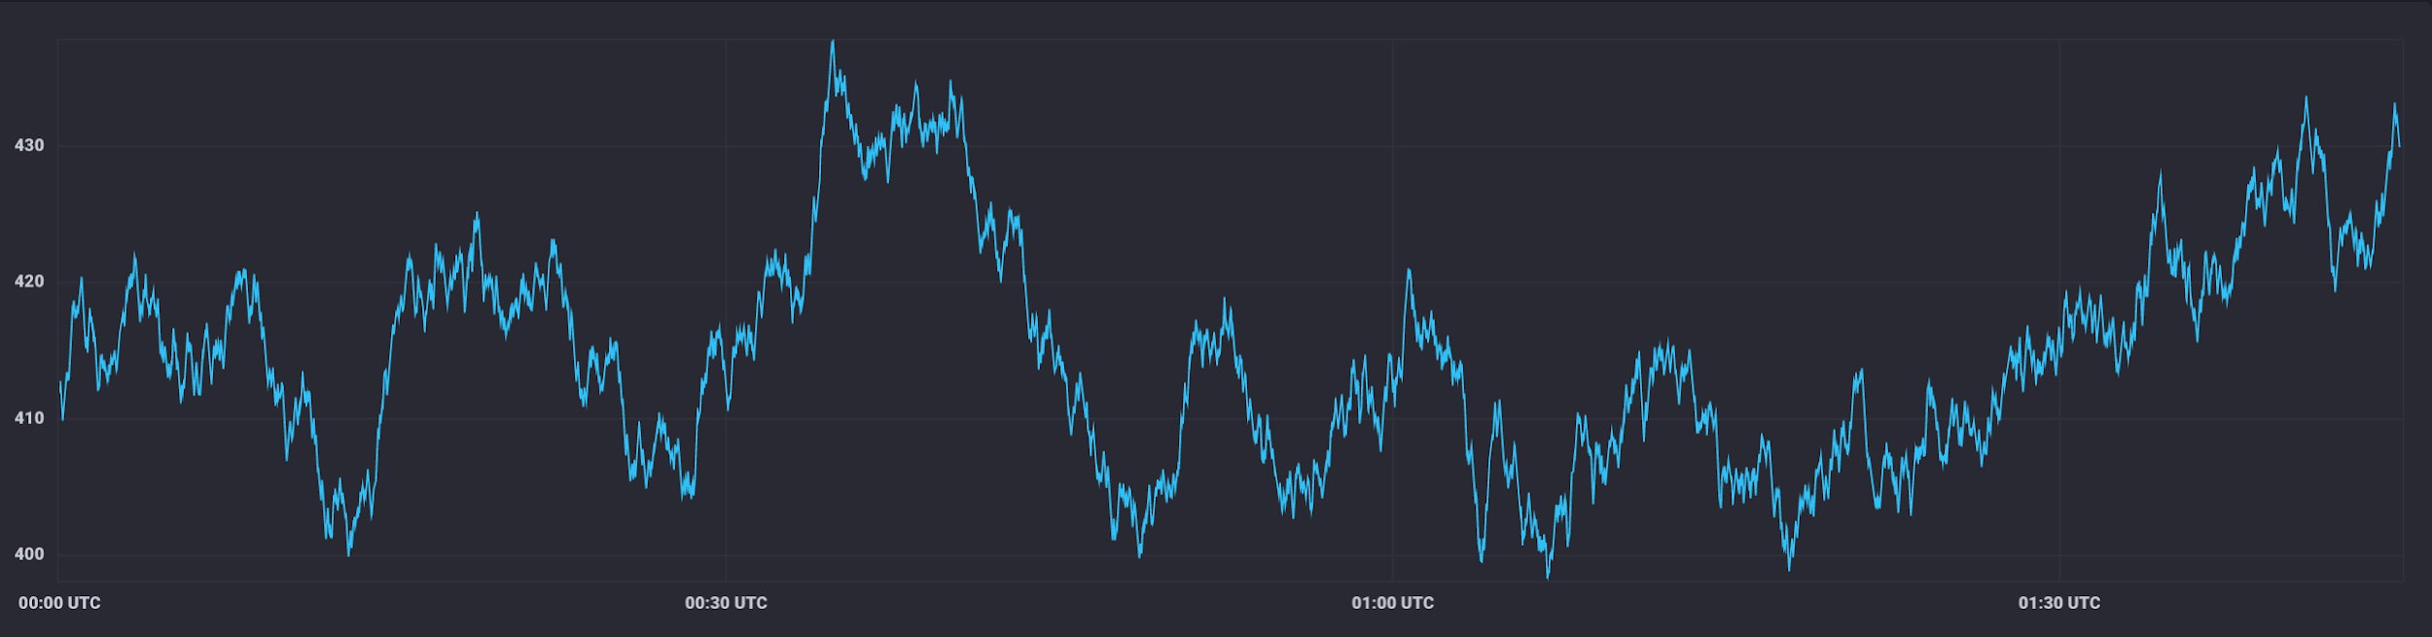
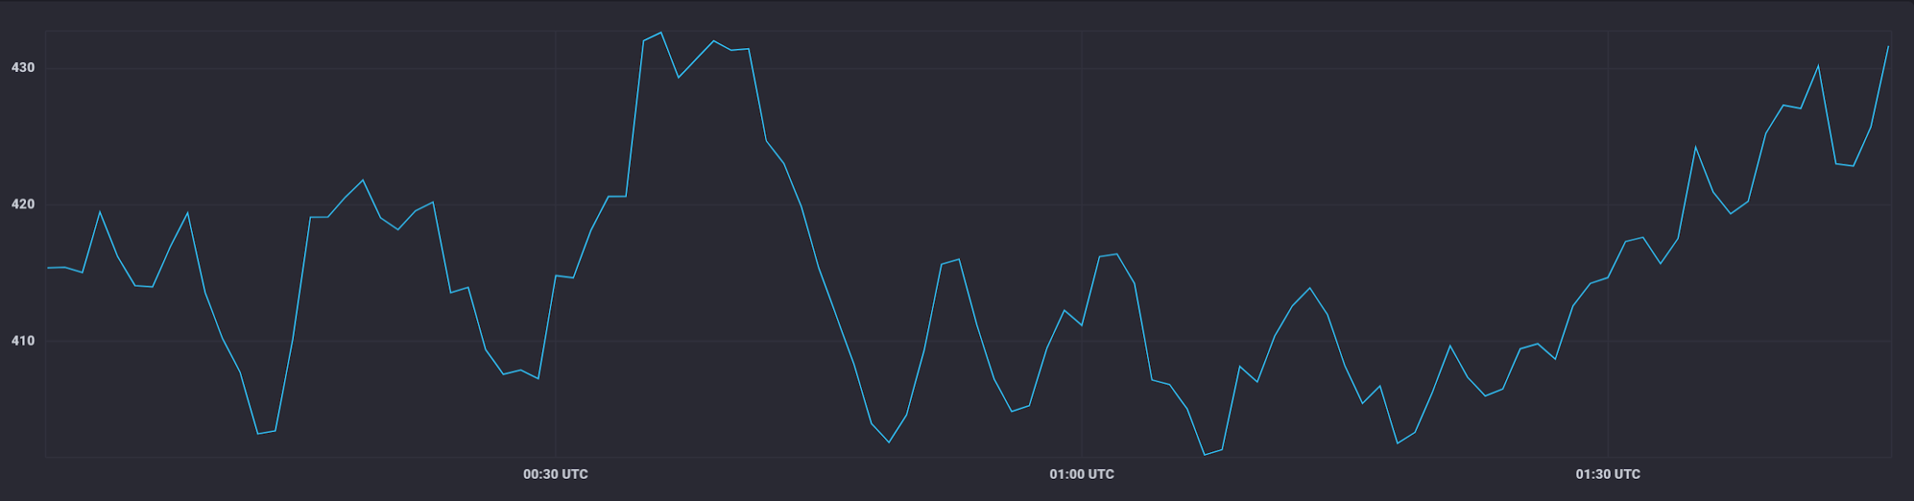
Typical use case: downsampling data
aggregateWindow(every: 1m, fn: mean)

Slide 111
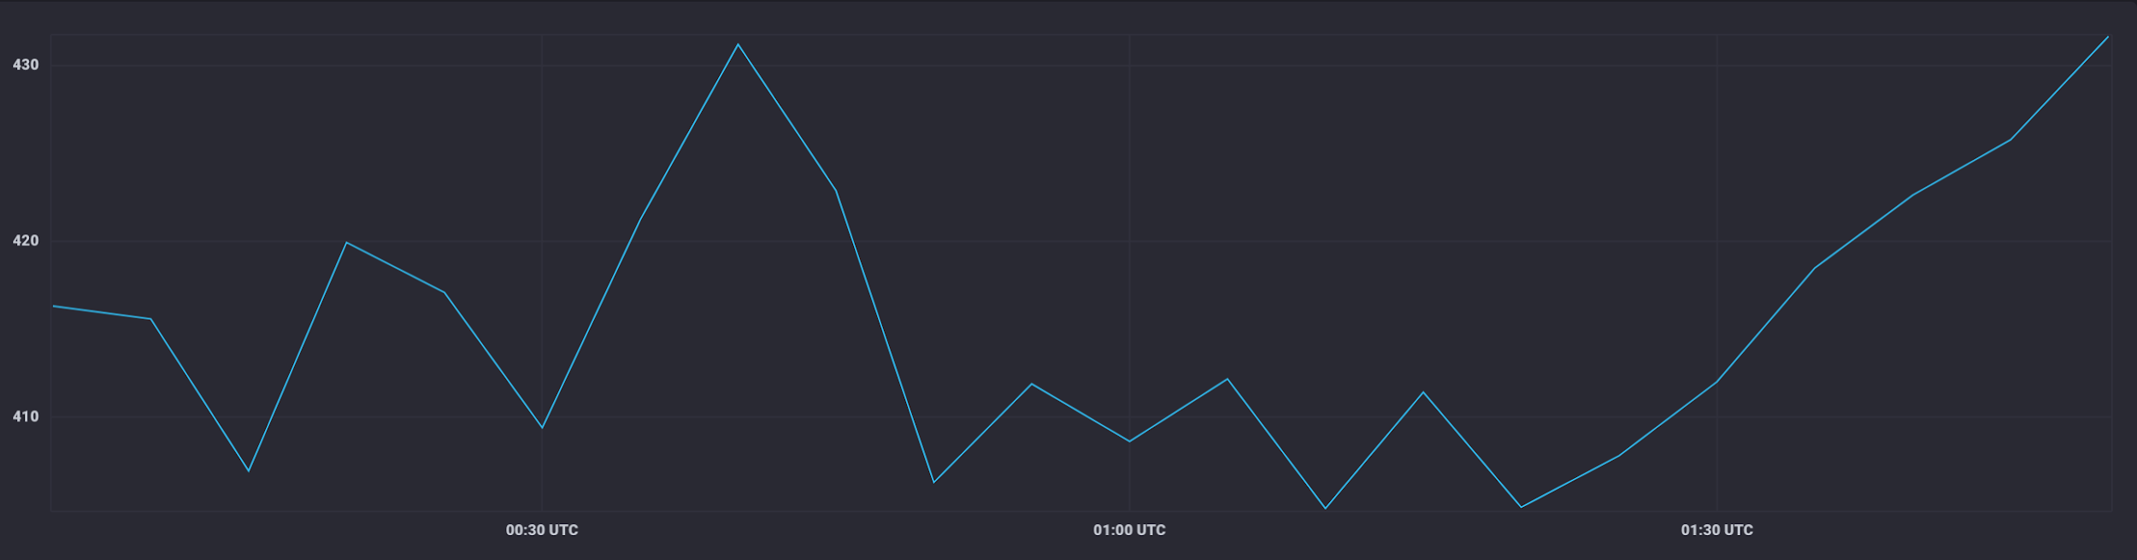
Typical use case: downsampling data (cont.)
aggregateWindow(every: 5m, fn: mean)

Slide 112
Let’s get dirty!
6

Slide 113
Continuous Linear Pizza Oven
Learning goals:
aggregateWindow

Slide 114
Task
Extract the moving average of the temperatures observed in the cooking base area over a window of 2 minutes
Extract the moving average of the temperatures observed by cheese melting area over a window of 3 minutes

Slide 115
Let’s do some live coding

Slide 116
Quiz
True or false
you can omit the range clause – ?
filtering can change the number of tables in the result – ?
shaping always changes the number of tables in the result – ?
processing can change the number of tables in the result – ?
aggregateWindow function is just a process step – ?
aggregateWindow function eases the downsampling task – ?
the parameter createEmpty of the aggregateWindow function can change the number of tables in the result – ?

Slide 117
Quiz
True or false
you can omit the range clause – F
filtering can change the number of tables in the result – ?
shaping always changes the number of tables in the result – ?
processing can change the number of tables in the result – ?
aggregateWindow function is just a process step – ?
aggregateWindow function eases the downsampling task – ?
the parameter createEmpty of the aggregateWindow function can change the number of tables in the result – ?

Slide 118
Quiz
True or false
you can omit the range clause – F
filtering can change the number of tables in the result – T (empty tables)
shaping always changes the number of tables in the result – ?
processing can change the number of tables in the result – ?
aggregateWindow function is just a process step – ?
aggregateWindow function eases the downsampling task – ?
the parameter createEmpty of the aggregateWindow function can change the number of tables in the result – ?

Slide 119
Quiz
True or false
you can omit the range clause – F
filtering can change the number of tables in the result – T (empty tables)
shaping always changes the number of tables in the result – F
processing can change the number of tables in the result – ?
aggregateWindow function is just a process step – ?
aggregateWindow function eases the downsampling task – ?
the parameter createEmpty of the aggregateWindow function can change the number of tables in the result – ?

Slide 120
Quiz
True or false
you can omit the range clause – F
filtering can change the number of tables in the result – T (empty tables)
shaping always changes the number of tables in the result – F
processing can change the number of tables in the result – T
aggregateWindow function is just a process step – ?
aggregateWindow function eases the downsampling task – ?
the parameter createEmpty of the aggregateWindow function can change the number of tables in the result – ?

Slide 121
Quiz
True or false
you can omit the range clause – F
filtering can change the number of tables in the result – T (empty tables)
shaping always changes the number of tables in the result – F
processing can change the number of tables in the result – F
aggregateWindow function is just a process step – F
aggregateWindow function eases the downsampling task – ?
the parameter createEmpty of the aggregateWindow function can change the number of tables in the result – ?

Slide 122
Quiz
True or false
you can omit the range clause – F
filtering can change the number of tables in the result – T (empty tables)
shaping always changes the number of tables in the result – F
processing can change the number of tables in the result – F
aggregateWindow function is just a process step – F
aggregateWindow function eases the downsampling task – T
the parameter createEmpty of the aggregateWindow function can change the number of tables in the result – ?

Slide 123
Quiz
True or false
you can omit the range clause – F
filtering can change the number of tables in the result – T (empty tables)
shaping always changes the number of tables in the result – F
processing can change the number of tables in the result – F
aggregateWindow function is just a process step – F
aggregateWindow function eases the downsampling task – T
the parameter createEmpty of the aggregateWindow function can change the number of tables in the result – T

Slide 124
Basic Data Analysis
Emanuele Della Valle
Prof. @ Politecnico di Milano
Founder & Partner @ Quantia Consulting
Marco Balduini
Founder & CEO @ Quantia Consulting
Riccardo Tommasini
Prof. @ INSA Lyon (France)

